Slide 1
Mid-Western Regional Council
Contract Management System
Introducing the Supplier Hub

Slide 2
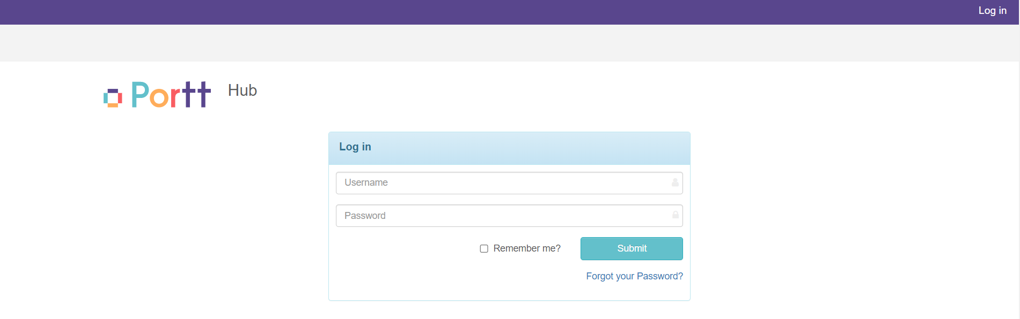
What is the Supplier Hub?
Mid-Western Regional Council are introducing an online tool to support improved communication and contract management with Suppliers (vendors / contractors).
Supplier Hub is the online tool that you can use to:
  Access information on your awarded contracts
  Provide information to Council (documents, assessments, etc.)
  Update your own Insurance information
  Be allocated tasks or actions in relation to an awarded contract.
The online tool is provide by a company call Portt.

Slide 3
Why is MWRC introducing the Supplier Hub?
As an organisation, MWRC want to improve and become better at what we do, and how we work with our suppliers.
  A new procurement framework, contract management framework and also our management of supplier compliance and communication is being implemented internally.
Within Council, there is a new system known as ‘Portt”, which will support the management of contracts, internally within Council, and with our Suppliers.
IMPORTANT NOTE: Portt is an additional software for Contract Management.
  VendorPanel will still be utilised as our e-tendering portal to source and set up contracts.
  Once a contract is awarded, MWRC will use the Portt system to manage awarded contracts.

Slide 4
How will the Supplier Hub help you?
The Supplier Hub will assist with:
  Upload your compliance requirements for example required insurance documents, licence requirements or induction evidence.
    Some of you may have utilised VendorPanel previously for compliance management, however, the new Portt system will now replace that activity.
  Track procurement activities related to your Contracts with Council
  Send and receive documentation on your Contract/s from Council
  Easily communicate with Council on risk, issues and queries on your Contract

Slide 5
How does the Supplier Hub work?

Slide 6
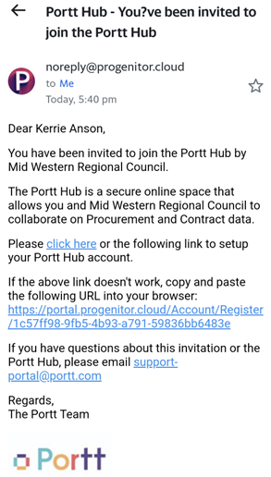
Receiving an invitation
First thing will be receipt of an invitation to the Supplier Hub (from @progenitor.cloud email address).
You will then need to complete the registration of the invitation (set up password to access the system).
  You will be supported by MWRC Procurement with your set-up
Once you have completed Registration, MWRC will be informed via the system, and they can start sharing information with you.

Slide 7
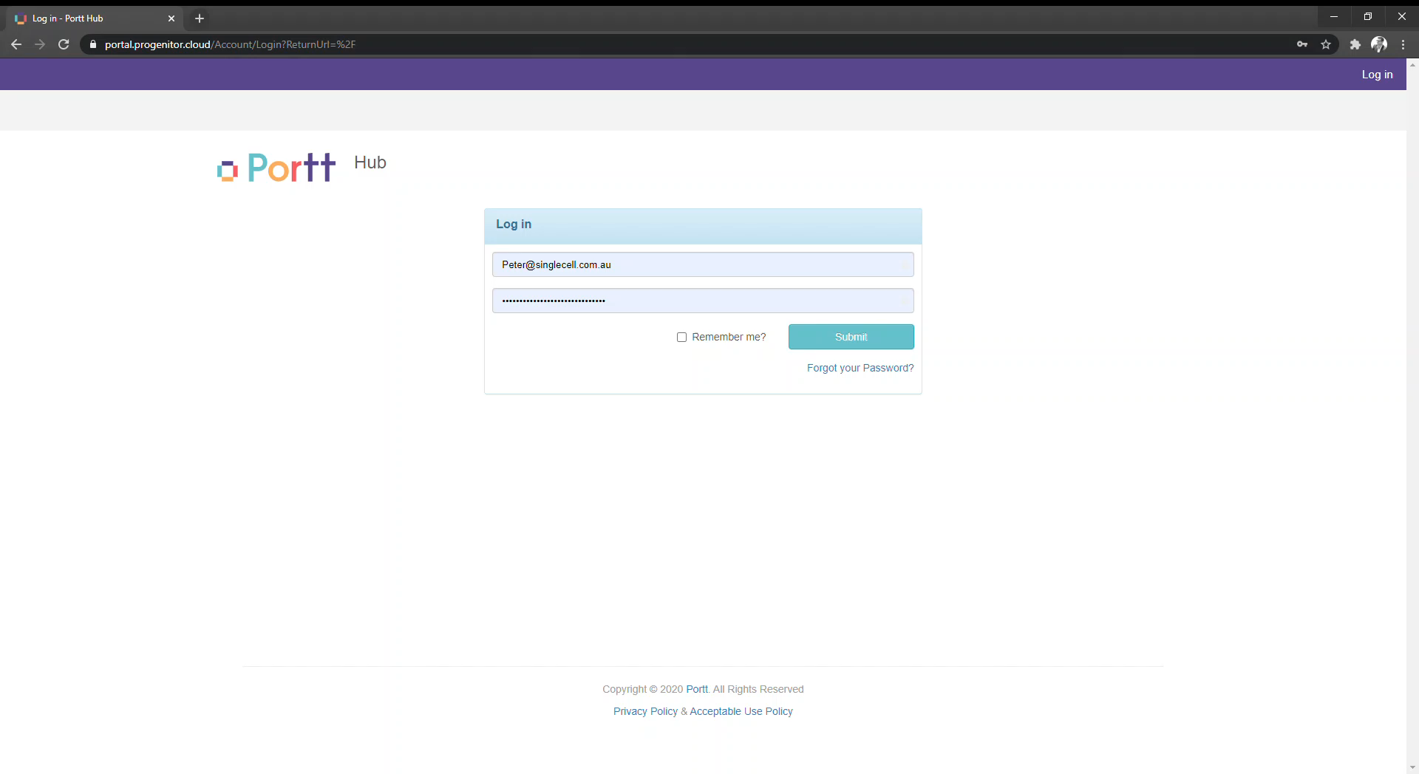
Overview of Supplier Hub

Slide 8
How are MWRC rolling out access to the Supplier Hub?

Slide 9
Next steps
Slowly rolling out access to the Supplier Hub
Invitation to access the Supplier Hub will start with Suppliers who have been awarded to the Wet and Dry Hire Panel and Arborists Panel for MWRC (within next month)
Then by Panel, and by Contract, as required.
Next Steps:
Wait to receive your invitation (remember, it will come from a @progenitor.cloud email address)
Follow the link and Register (using your email and set up a password) and log into the Supplier Hub
Wait for MWRC to share a contract with you (you will receive another email)
If you have any questions, reach out to the Procurement Team at Mid-Western Regional Council:
Procurement.Helpdesk@midwestern.nsw.gov.au
NOTE: MWRC will be shut down 22nd December to 3rd January

Slide 10
overall_0_131600703271538582 columns_1_131600694444874709
Questions

